Slide 1
Senior Design Project Proposal Group 3(D POV)
Philip Geramian, Alex Julian, Lyle Moffit, Roman Olesh
Syracuse University College of Engineering and Computer Science
January 27, 2015
Notes:
ALL – No more than 30 seconds.

Slide 2
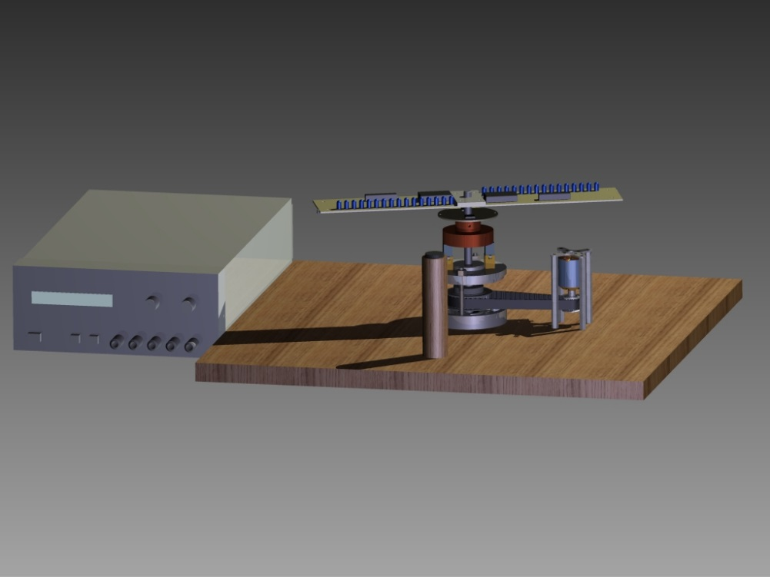
3DPOV Display - Project Overview
Notes:
ROMAN – Approx. 1 minute

Slide 3
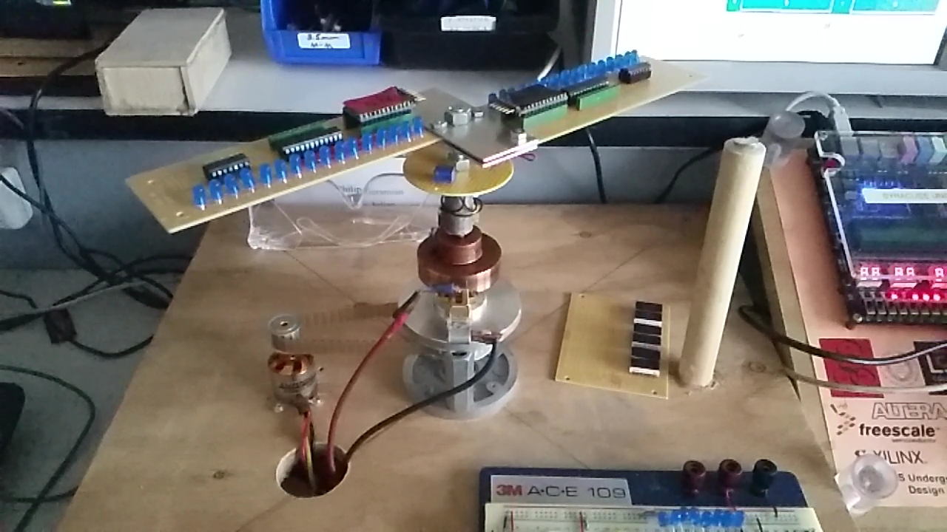
Proof of Concept – Video, Details
Notes:
ALEX – Approx. 2 minutes

Slide 4
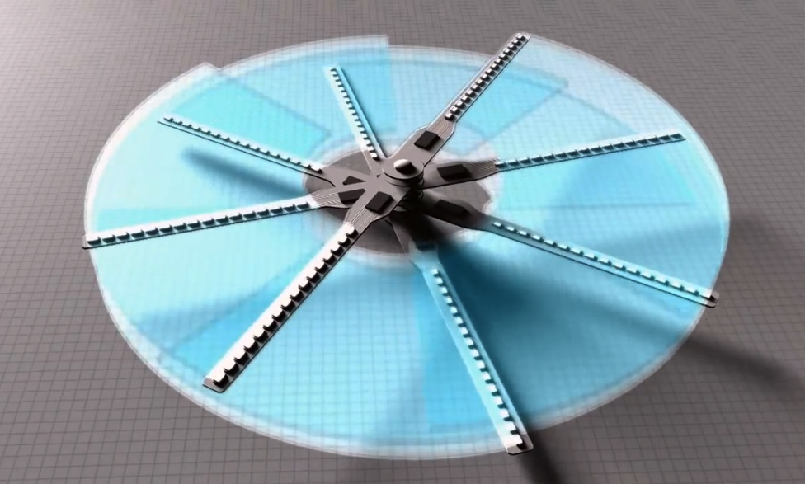
3DPOV Display – Moving to 3D
www.maxmali.com/visio
Notes:
LYLE – Approx. 1 minute?
- So that is what we’ve accomplished to date…
- The LED blades are layered to create the effect of 3D display.

Slide 5
3DPOV Display – Game Plan
µController
Concurrency
Speed
Data Storage
32 per Wing
Stack Vertically
LED Display
Increase Capacity
Wireless Distribution
Power Systems
Current Draw from LEDs
Noise Filtering
Notes:
LYLE & ROMAN

Slide 6
Engineering Challenges & Tasks Ahead
New Power Electronics
Higher Amperage Electronic Speed Controller
New Hall Effect Sensor
Laying out and printing custom PCBs
Hardware design refinement and decisions
Plexiglass enclosure
Mechanical tweaks/fixes
Memory and Communications
Notes:
PHIL – Approx. 2 minutes

Slide 7
3DPOV – Potential Cost Analysis
Notes:
Phrillah G’zus – 30 sec.

Slide 8
3DPOV Display – Open House
What can you expect to see?
Notes:
ALEX

Slide 9
Questions?
Contact aejulian@syr.edu for more information
Notes:
– Approx. 2 minutes (hopefully)

